Slide 1



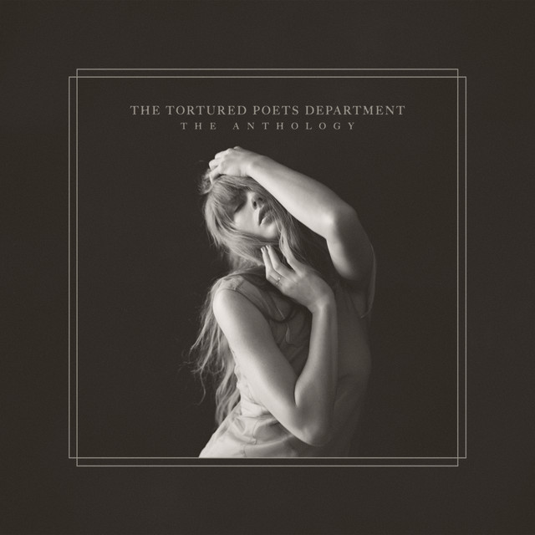
The Suffering Data Scientists Department
WHERE POETRY MEETS PAIN
DS 5030
November 13, 2025
Erin Siedlecki, Shaveen Saadee, Anna Li, Emily Garman, Razan Habboub, & Marissa Burton
Journal Presentation

Slide 2


AGENDA
The Data
Markov Transition Model
Our Model
Results
Conclusion

Slide 3

The Data: Chordonomicon
Consists of data from 666,000 chord progressions and their corresponding song’s release date, decade, genre, and Spotify song and artist IDs
Created by researchers at Artificial Intelligence and Learning Systems Laboratory at the National Technical University of Athens
Collected the chord data using web scraping on the Ultimate Guitar platform and Spotify Web API
Goal was to generate a large-scale dataset that can be used for advanced machine learning
Performed experiments on chord prediction and decade and genre classification
Our goal: to model Taylor Swift’s chord progressions and generate similar ones using a Markov Transition Model

Slide 4


Data Cleaning & Inspection
We limited our search to music by Taylor Swift, ending up with 185 songs
To clean the data, we formatted the source data and mapped chords to a 12-semitone binary representation
The data is updated as of 12/3/24, so not all of Taylor Swift's music is captured
We found missing values in the original dataset (filtered for Taylor Swift) for the columns release_date, decade, rock_genre, and spotify_song_id
None of the columns containing missing values are used in our chord-specific dataset which will be used to create the chord generator, so we are not concerned with the presence of these missing values
Notes:
Data cleaning – removed chord inversions, any structural labels

Slide 5


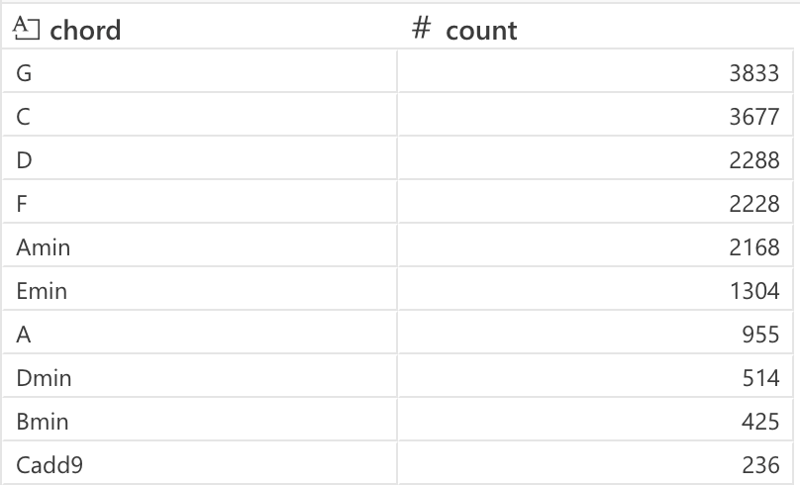
Chord Progressions are sequences of chords forming the harmonic foundation of music, shaping a song’s mood and emotional tone
Example contrasts:
“Blackbird” - The Beatles: soft and gentle / G - Am7 - G/B - G (I – ii⁷ – I⁶ – I)
“Fly Me to the Moon” - Frank Sinatra: jazz-style sequence / Am7–Dm7–G7–Cmaj7 (vi⁷ – ii⁷ – V⁷ – I⁷)
Genres differ: Rock/Jazz use complex progressions for depth, while Pop favors simple, catchy ones
Taylor Swift consistently uses three main chord progressions:
“Blank Space” → I–V–vi–IV (F – Dm – B♭ – C), I-V-vi-IV (F – C – Dm – B♭)
“You Belong With Me” → I–V–ii–IV (C - G - Dm - F)
“All Too Well” → I–V–vi–IV (C - G - Am - F)
Taylor Swift’s use of simple, repetitive progressions builds a cohesive musical identity, emphasizing lyrics and emotion over harmonic complexity
Modeling her progressions can reveal: chord transition patterns, dominant chord types, and structure trends across songs
Background

Slide 6



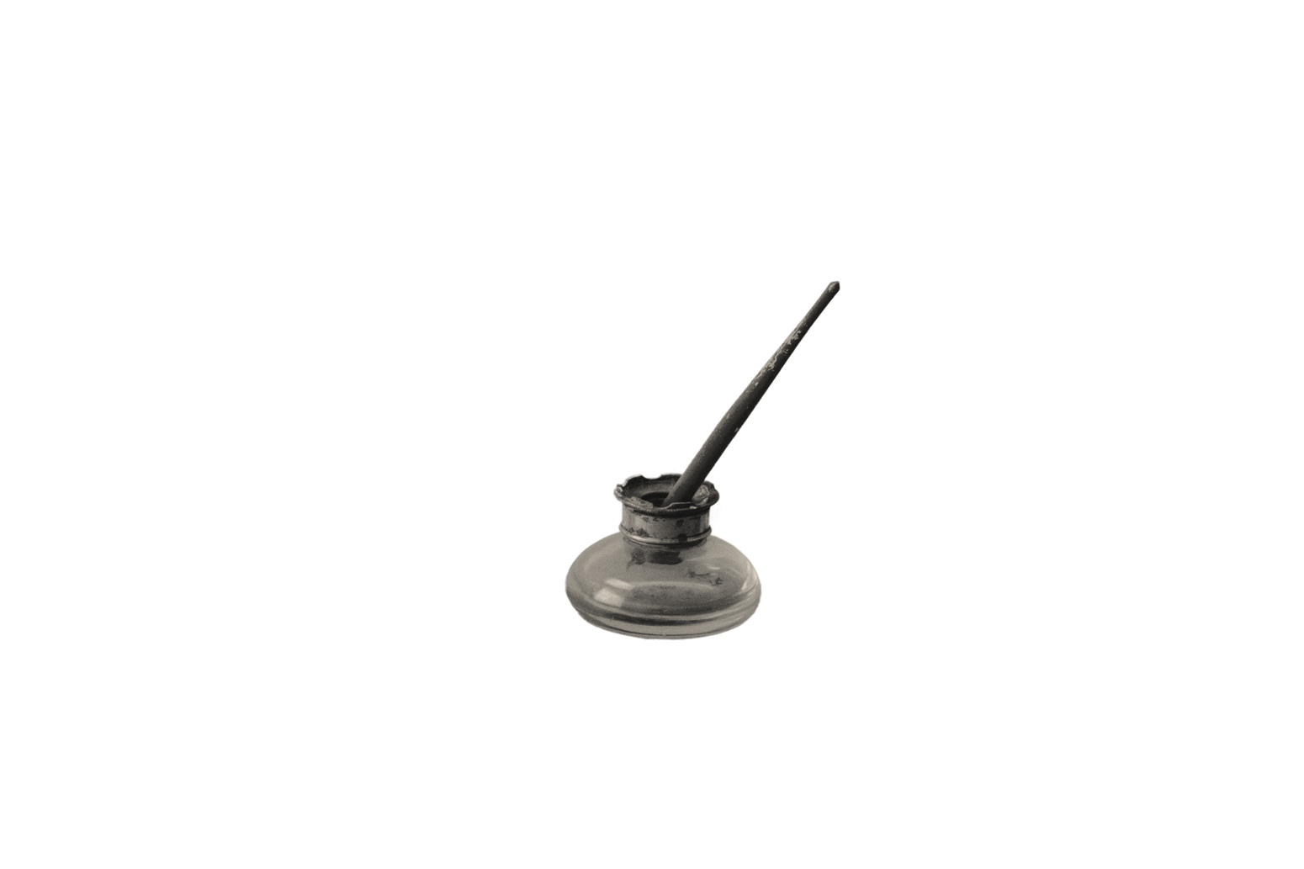
Markov Transition Model
The variable of interest is “chord”, which lends well to a Markov Transition Model (because values are categorical)
The Markov Chain allows us to examine a current observation (state) in a sequence and predict the next (and only the next) state based on prior data
For this data specifically, our goal is to create a state space of chord observations from prior Taylor Swift chord progression data
Our model will rely on the highest probabilities of one chord following another as opposed to what 4 chords together would mimic a Taylor Swift song best, which may lead to our state space sounding chaotic

Slide 7
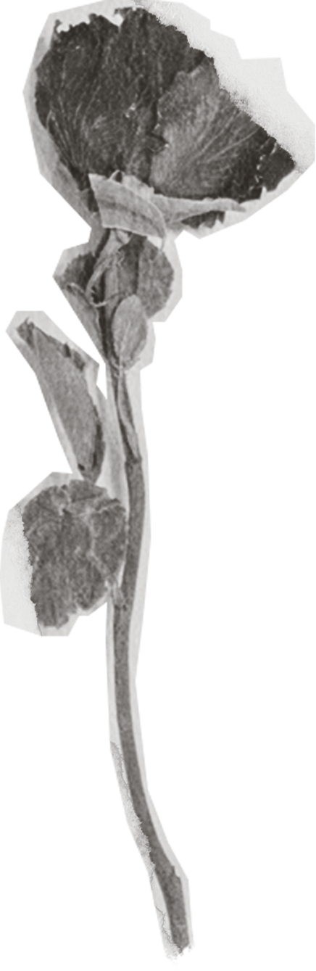
Our Model
Second-order model that looks at the previous two chords to determine the next chord
Initial state: C G
Better for capturing local musical structure
Simulation to generate a new sequence of chords that sound similar to Taylor Swift’s music transitions
Count how often each state is followed by another to compute transition probabilities
From the initial state, sample the next state based on transition probabilities
Keep sliding the two-chord window forward until you have enough

Slide 8
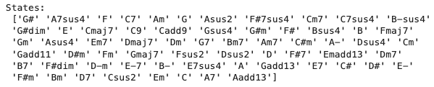
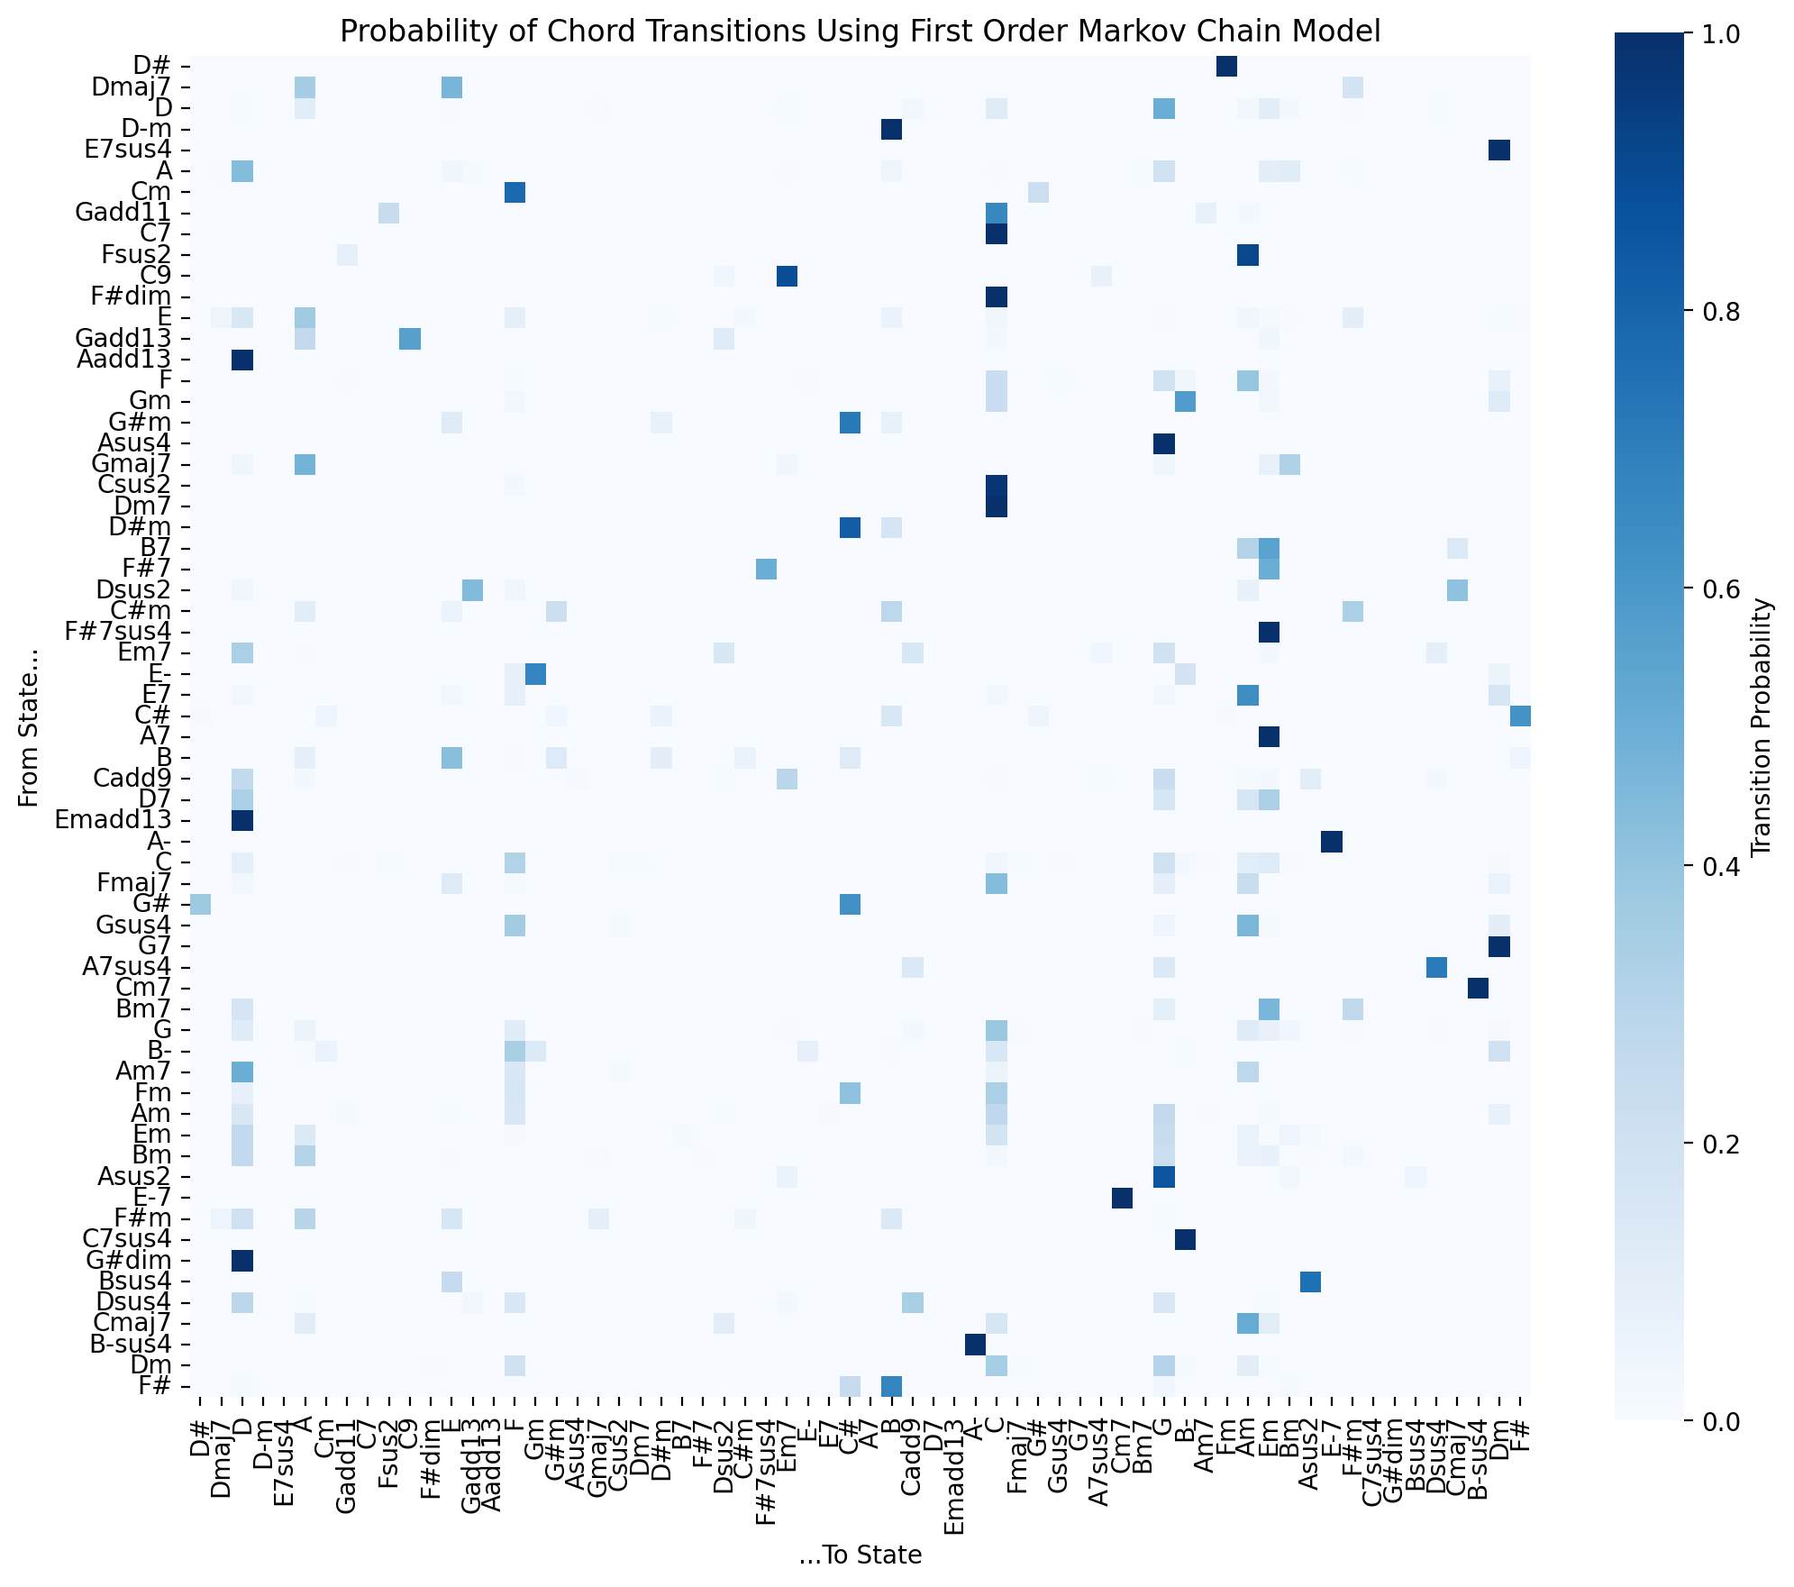
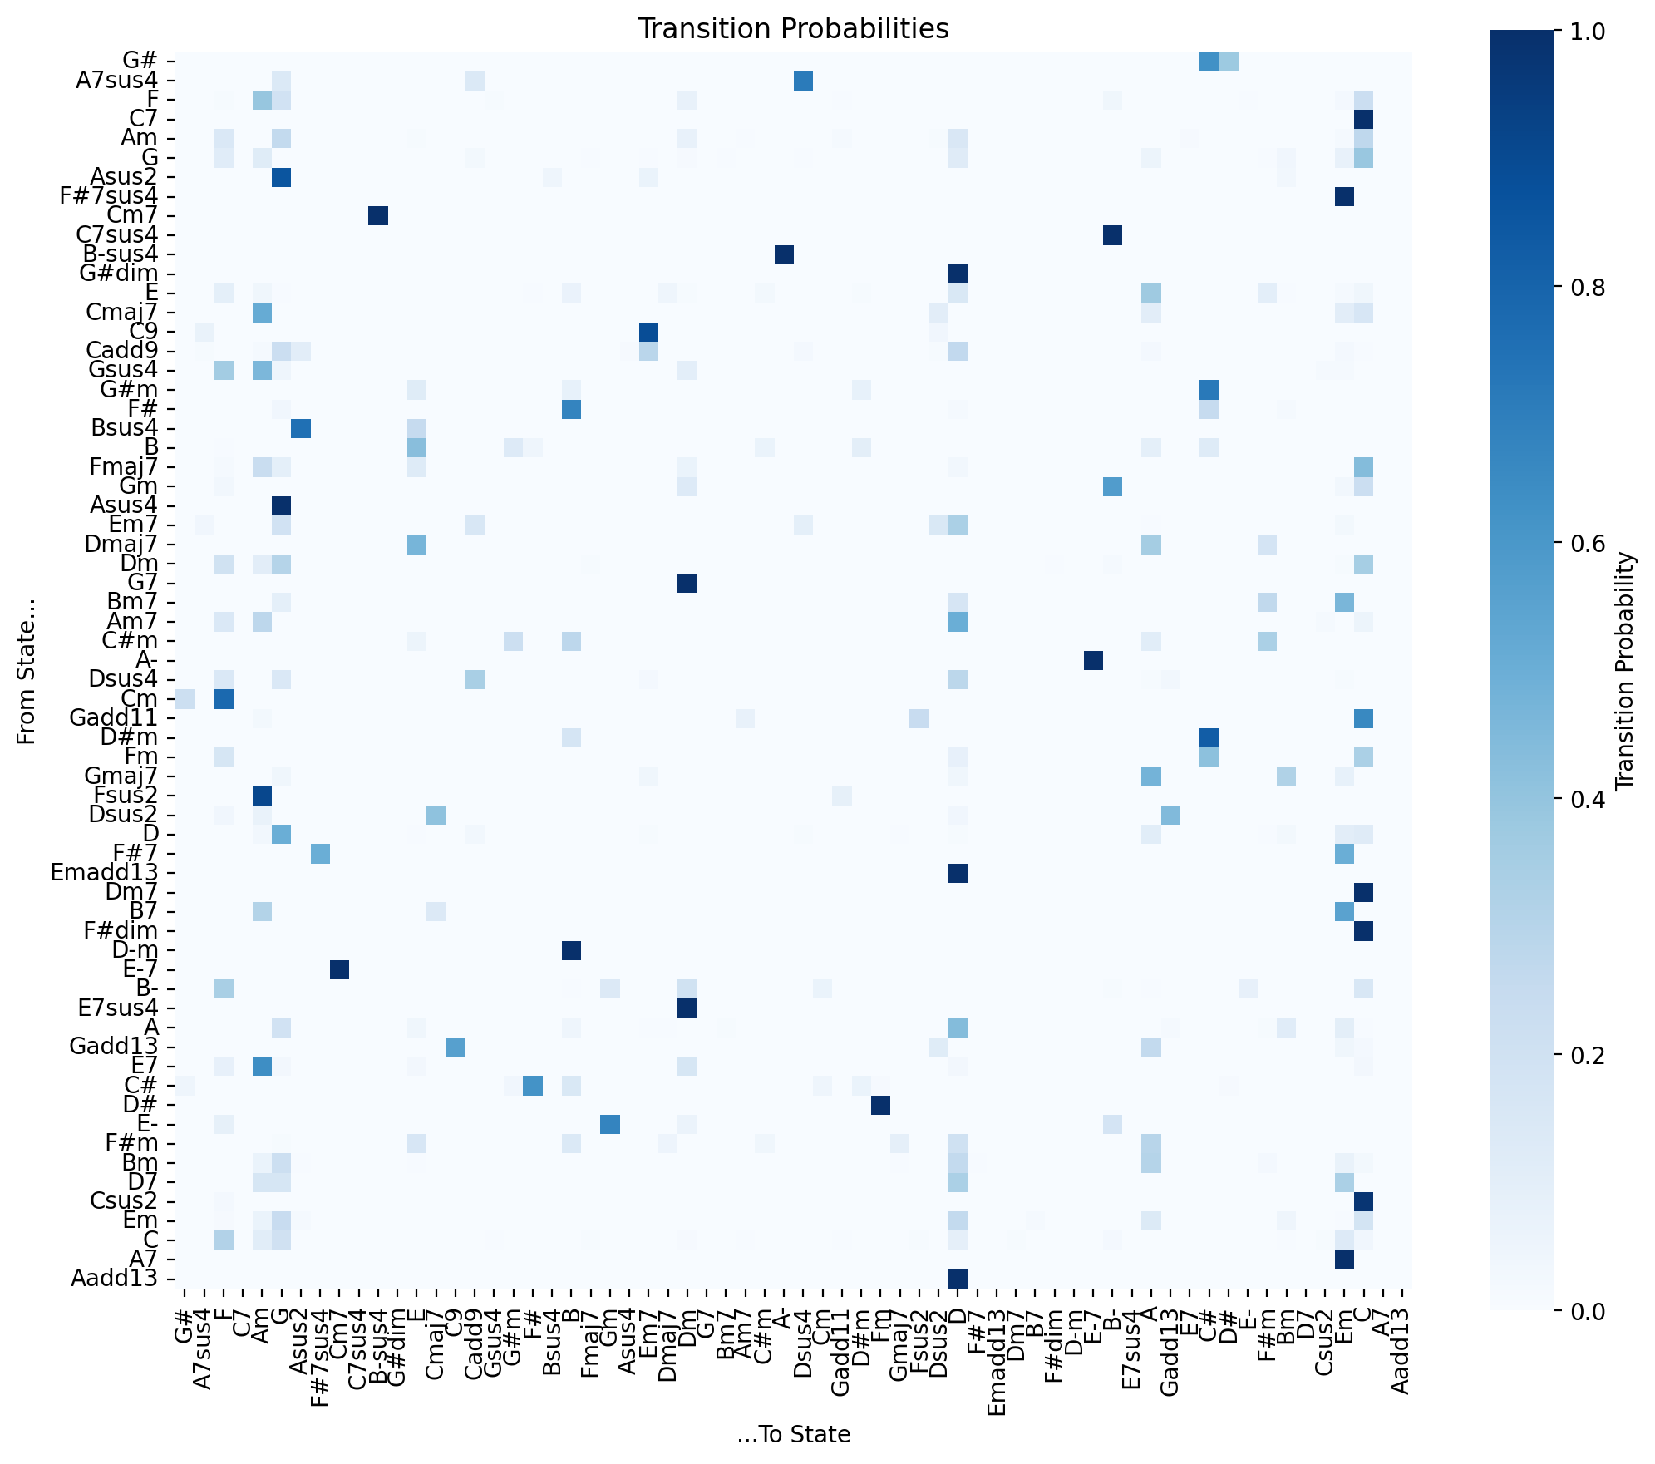
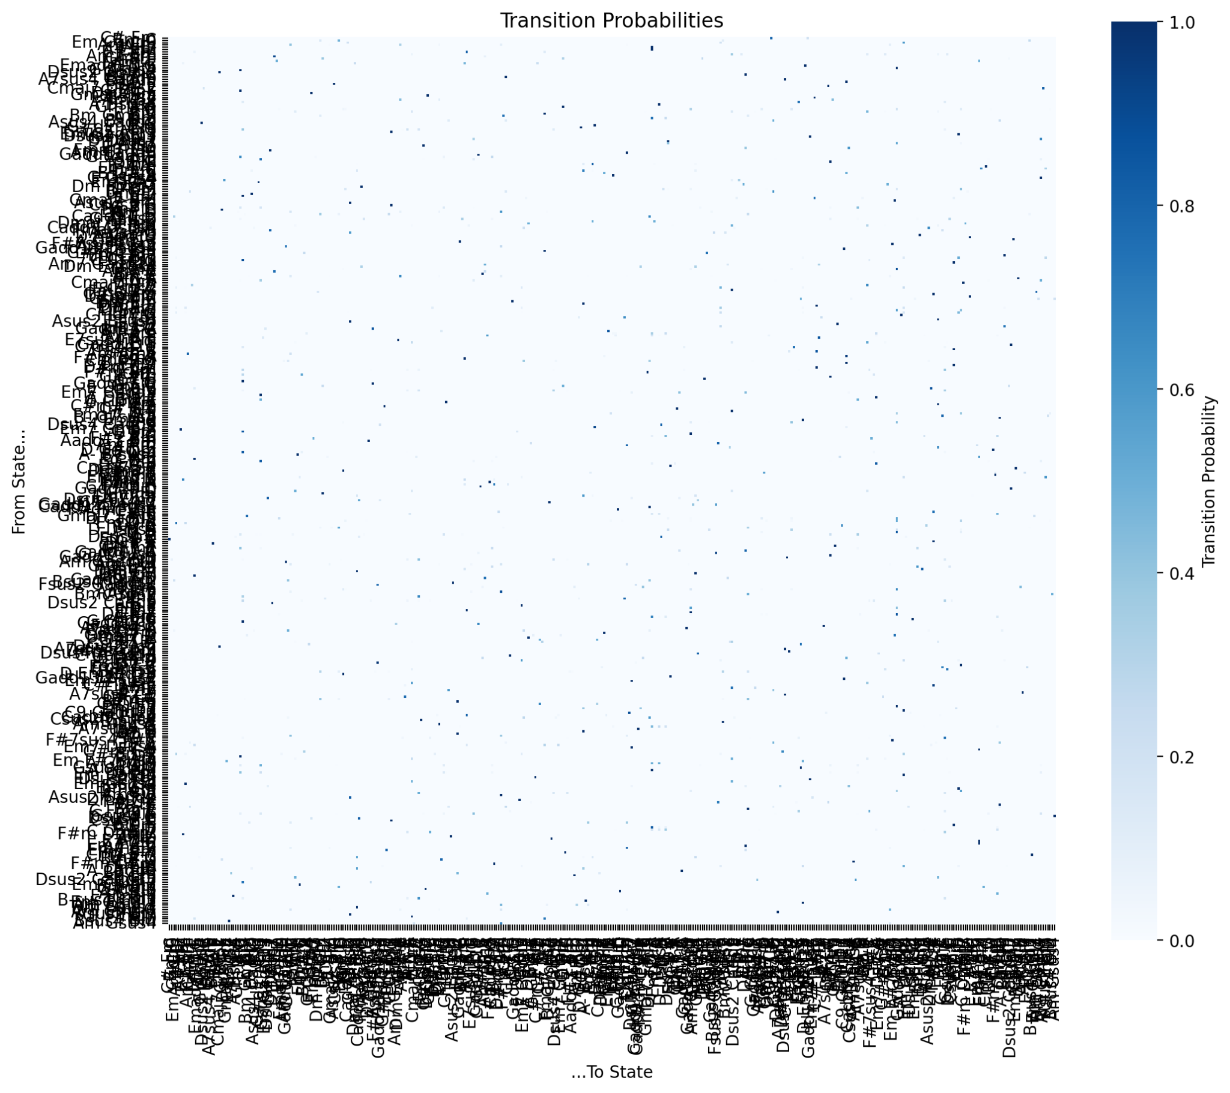
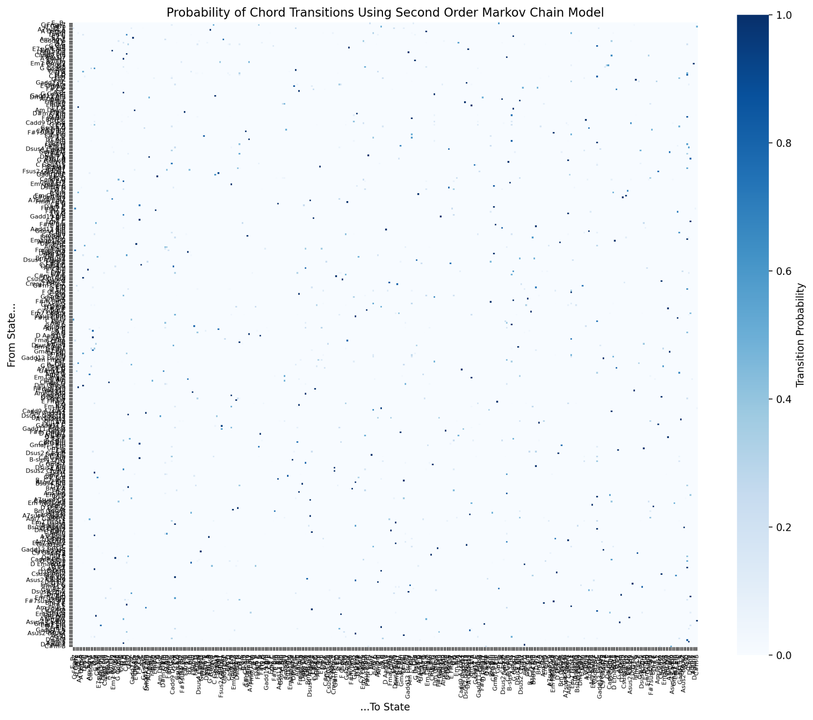
Our Model
Notes:
These are our transition matrices for first and second order markov models that show how some chords are more likely to follow others. Above is the state space.

Slide 9

A New Taylor Swift Collab…

Slide 10


So Long, Markov
Our model successfully reproduced the same set of chords as the training data and encoded plausible local transitions, but the simulated sequences differed perceptibly from the real songs
The generated MIDI sounded less coherent and lacked the larger-scale structure, repetition, and tonal stability present in the original compositions
Our approach effectively captured short-term dependencies between chords, but was limited by the simplicity of the Markov assumption and the sparsity of the training data
The probability that we accurately predict a chord progression longer than 2 chords is asymptotically close to 0, so we should not rely on a Markov chain to mimic a typical 4-chord progression in Taylor Swift’s discography
Our model ignored rhythm, melody, and long-range harmonic structure, which led to generated sequences that often sounded musically inconsistent compared to the original compositions
For future work we could use larger and more diverse datasets, apply smoothing or regularization to handle rare transitions, and/or explore higher-order or hybrid probabilistic models

Slide 11
Question…?

